Slide 1
Concurrency
Saint Petersburg, 2019

Slide 2
Content
1
Concurrent computing
2
Advantages
1
Performance
2
Resource utilization
3
Latency decreasing
3
Wonders
1
Races
2
Complexity
3
Tech issues
4
Conclusion

Slide 3
Hardware basics

Slide 4
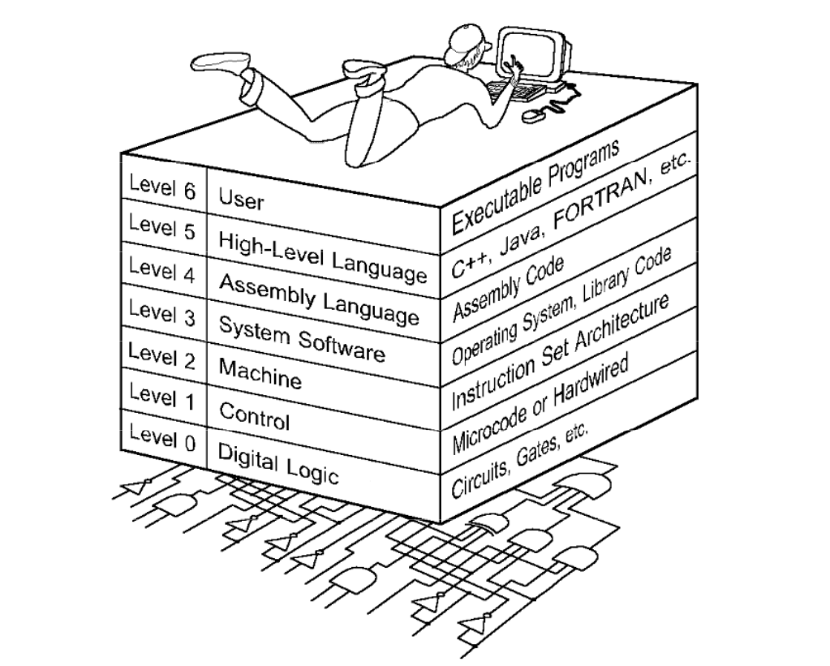
The World we are living in

Slide 5
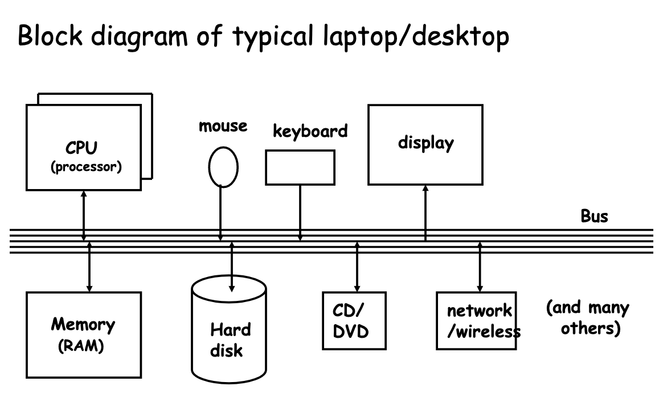
Computer architecture

Slide 6
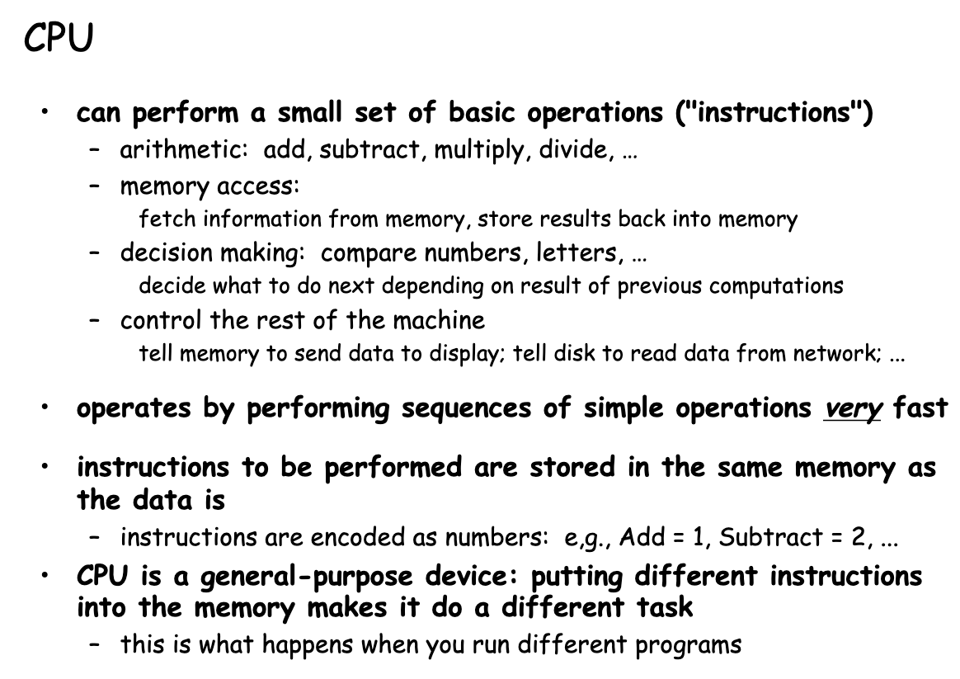
CPU

Slide 7
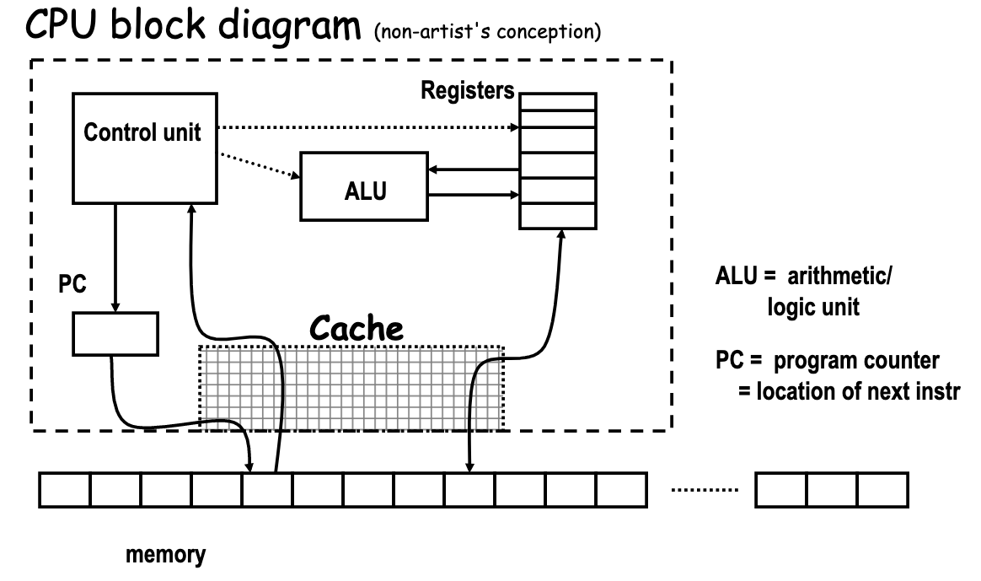
CPU

Slide 8
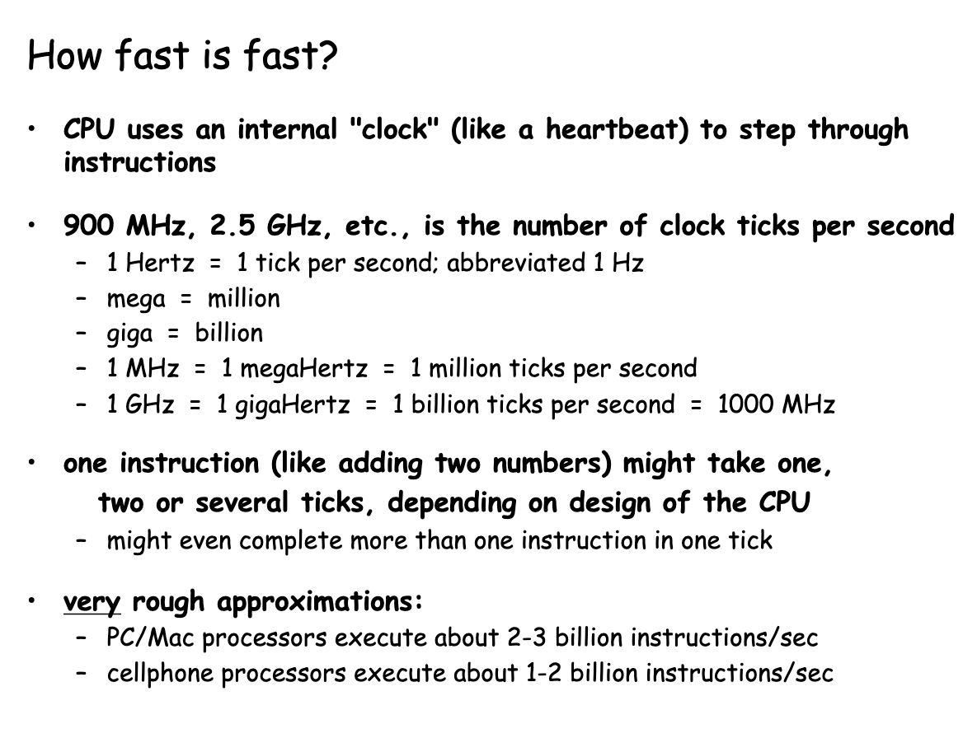
CPU

Slide 9
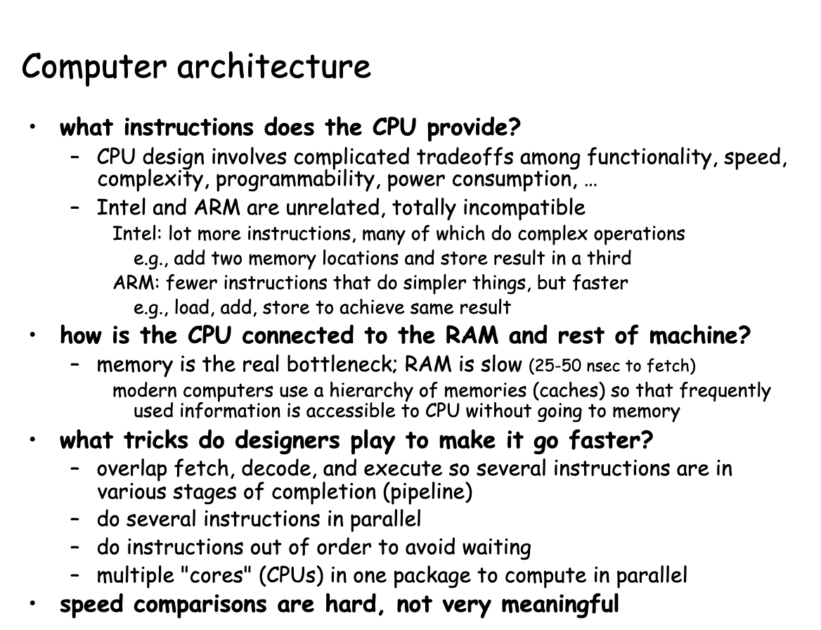
Computer architecture

Slide 10
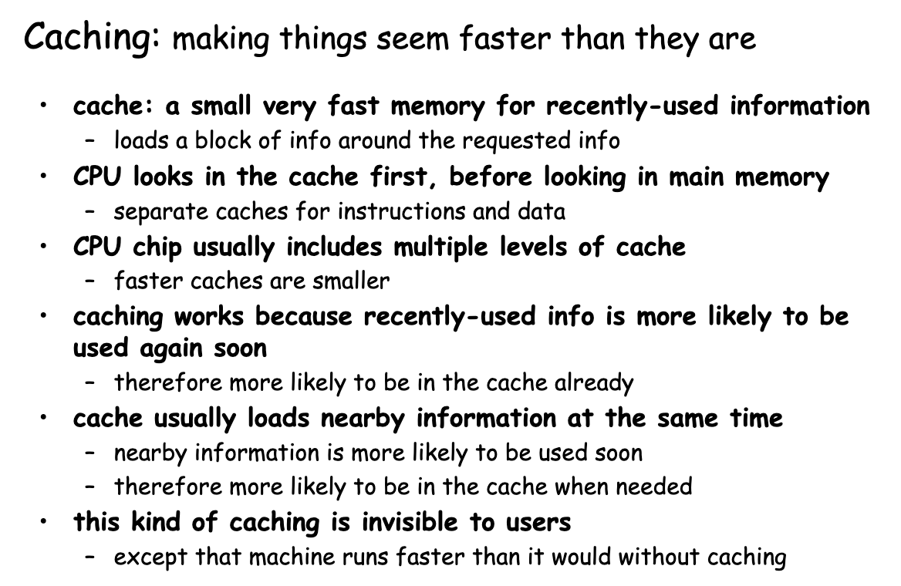
CPU architecture

Slide 11
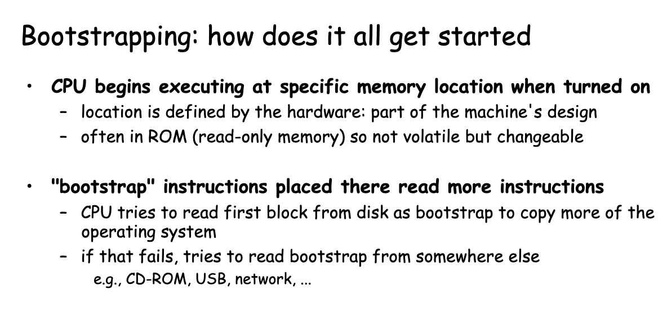
Bootstrapping

Slide 12
Software basics

Slide 13
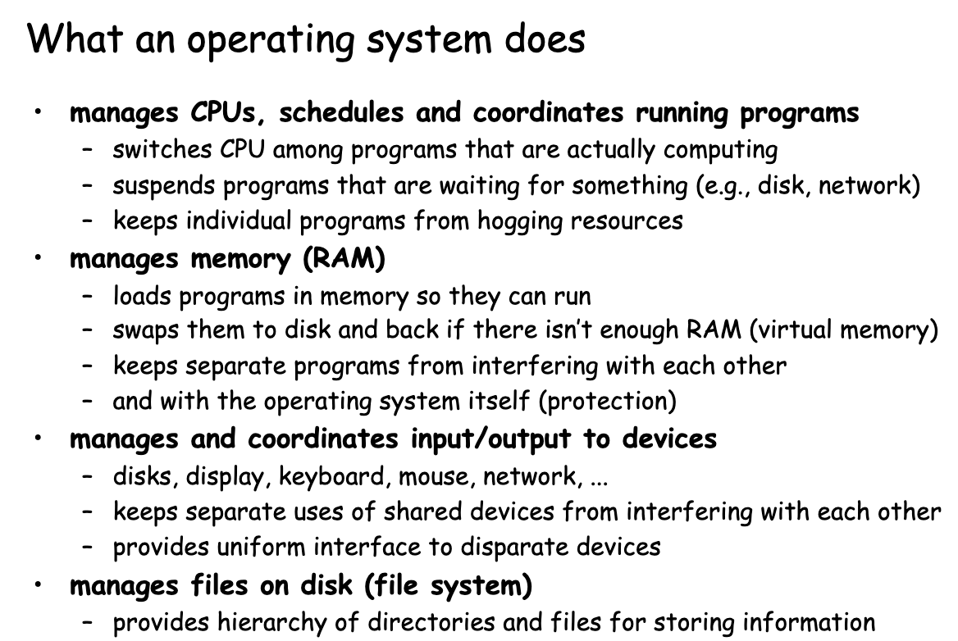
OS

Slide 14
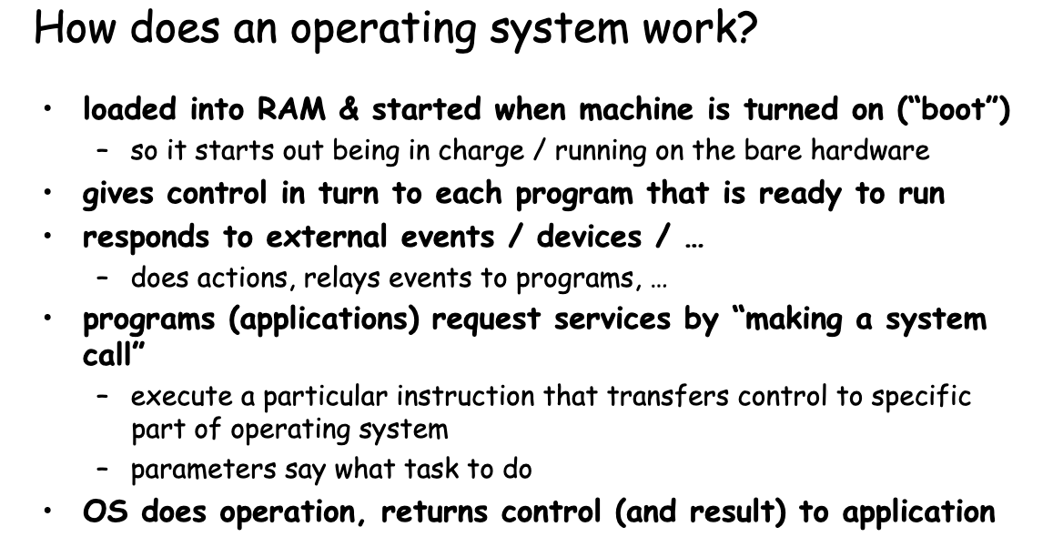
OS

Slide 15
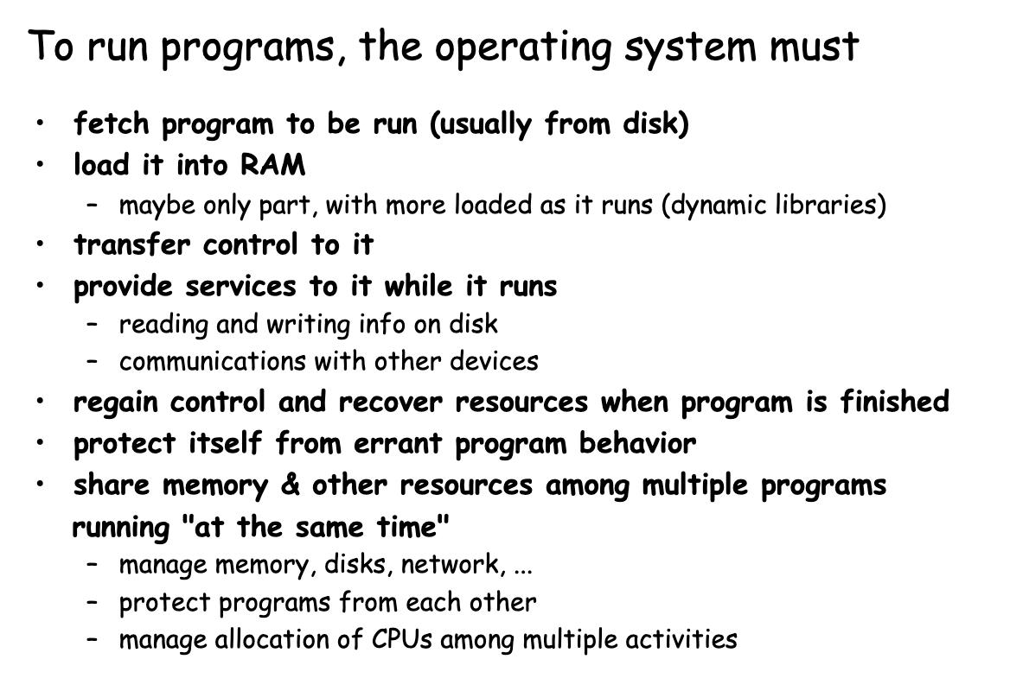
How to run programs?

Slide 16
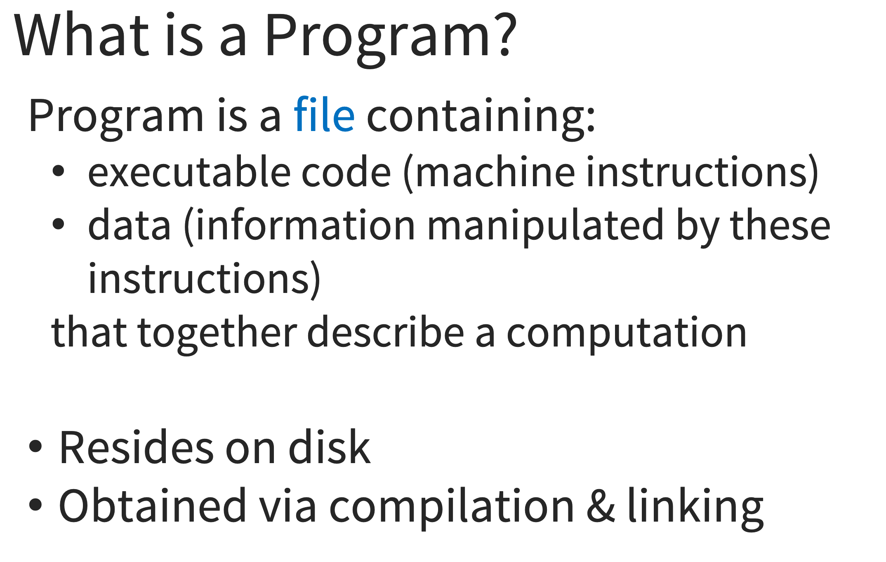
Programs

Slide 17
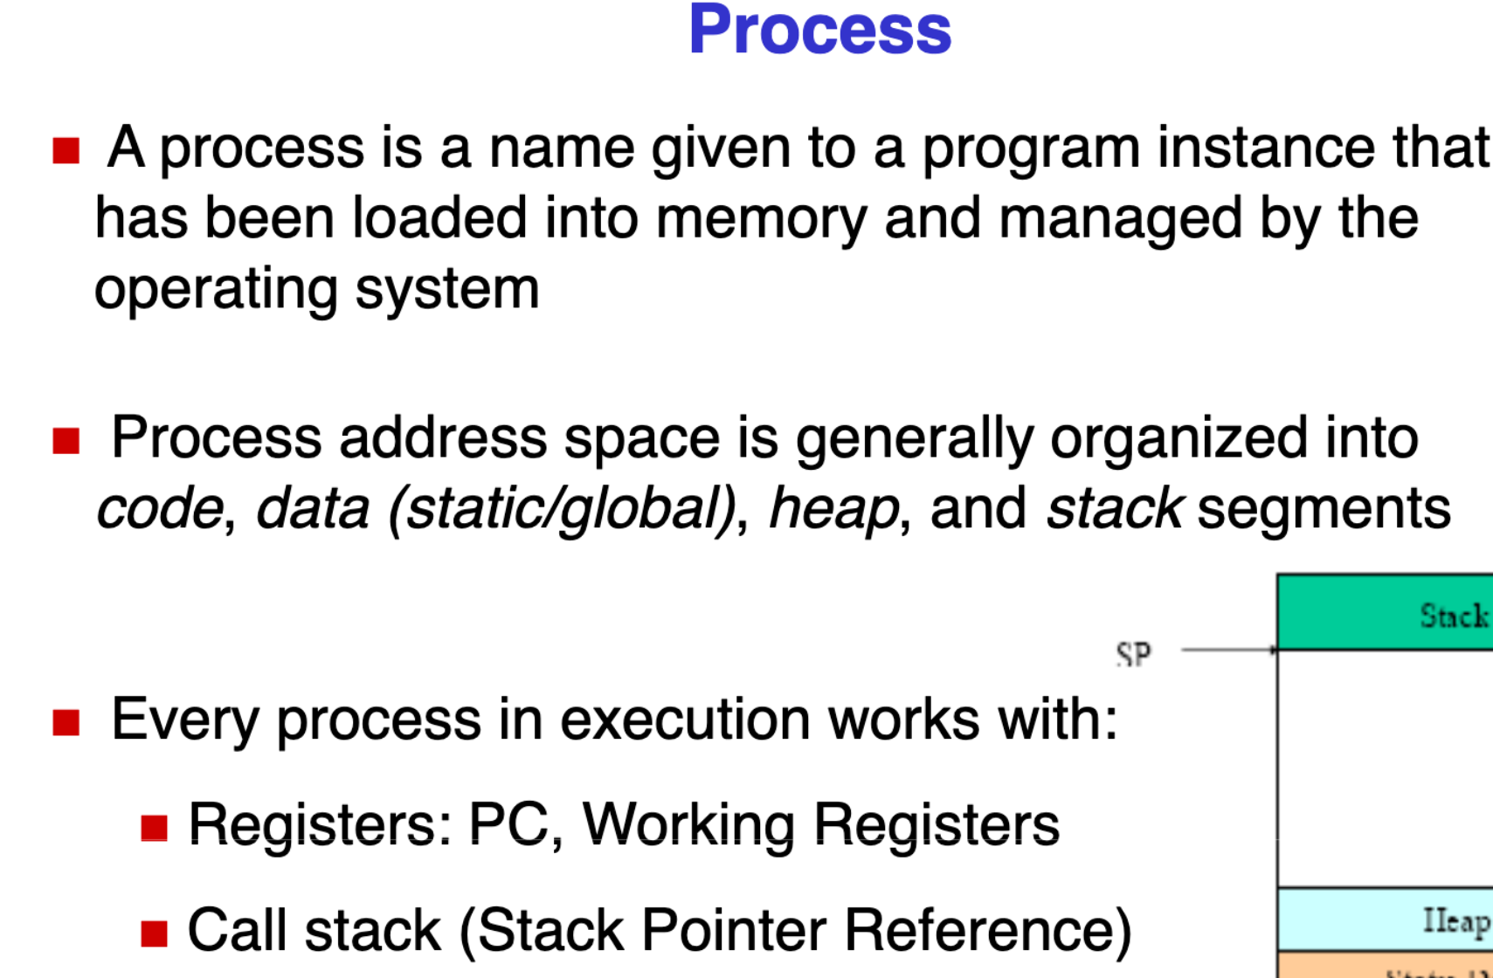
Process

Slide 18
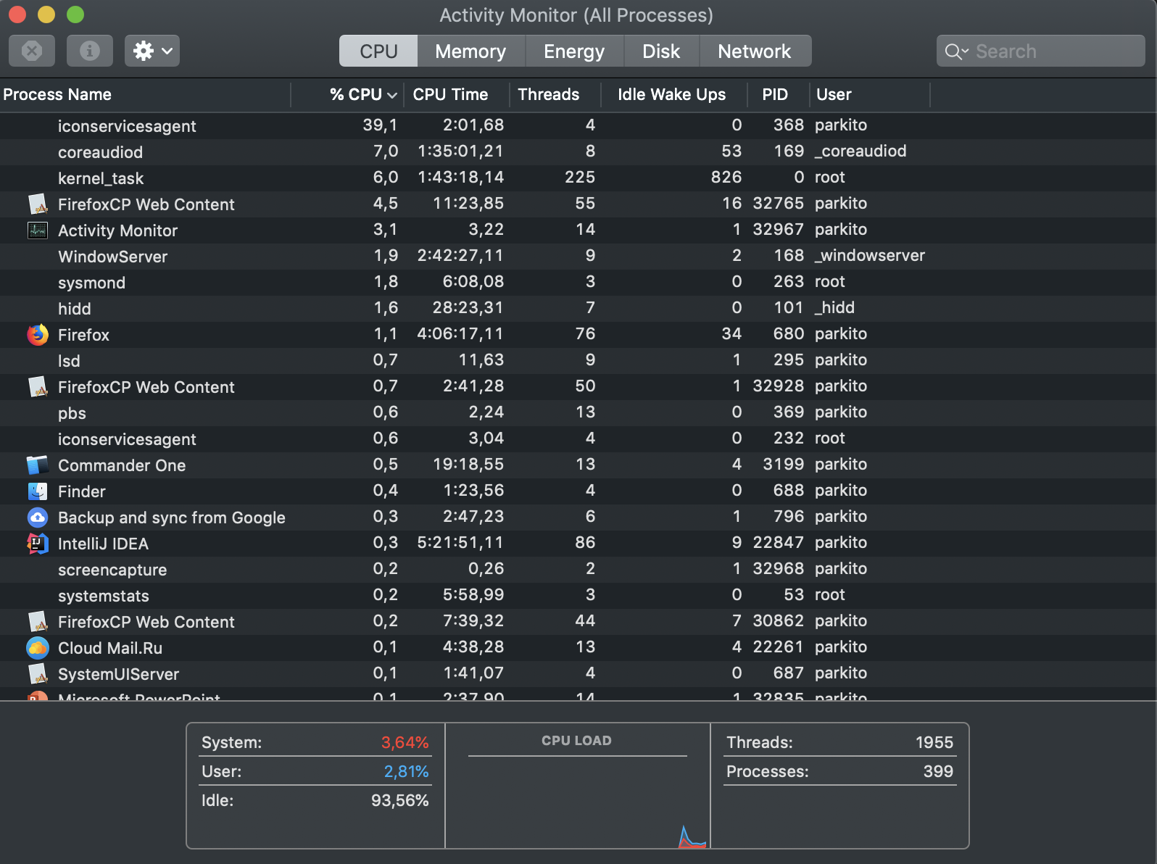
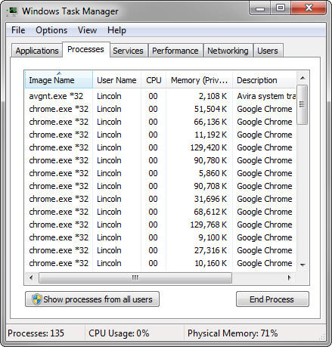
How processors work?

Slide 19
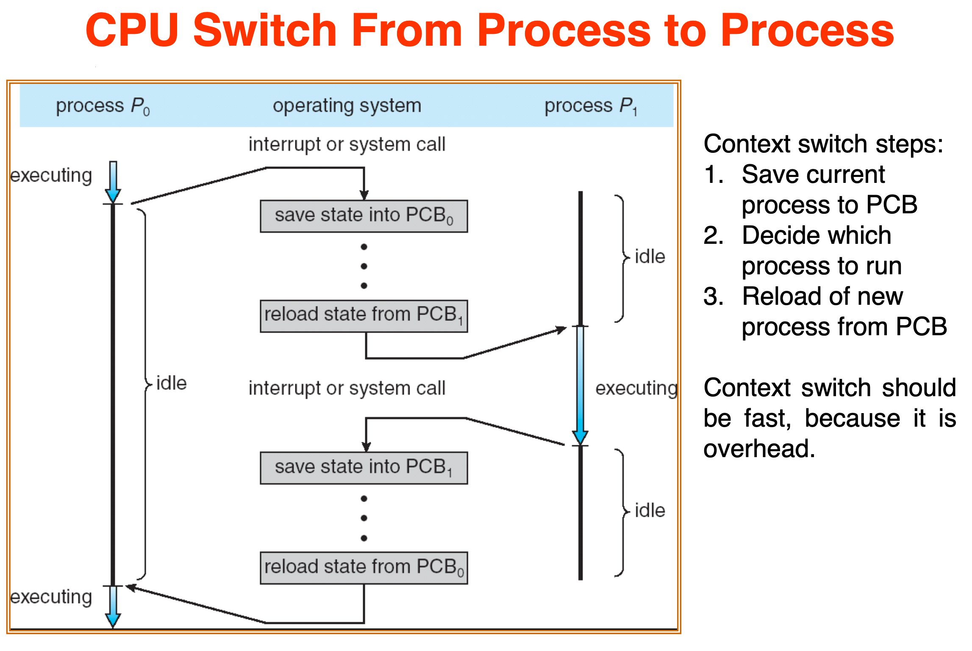
How processors work?

Slide 20
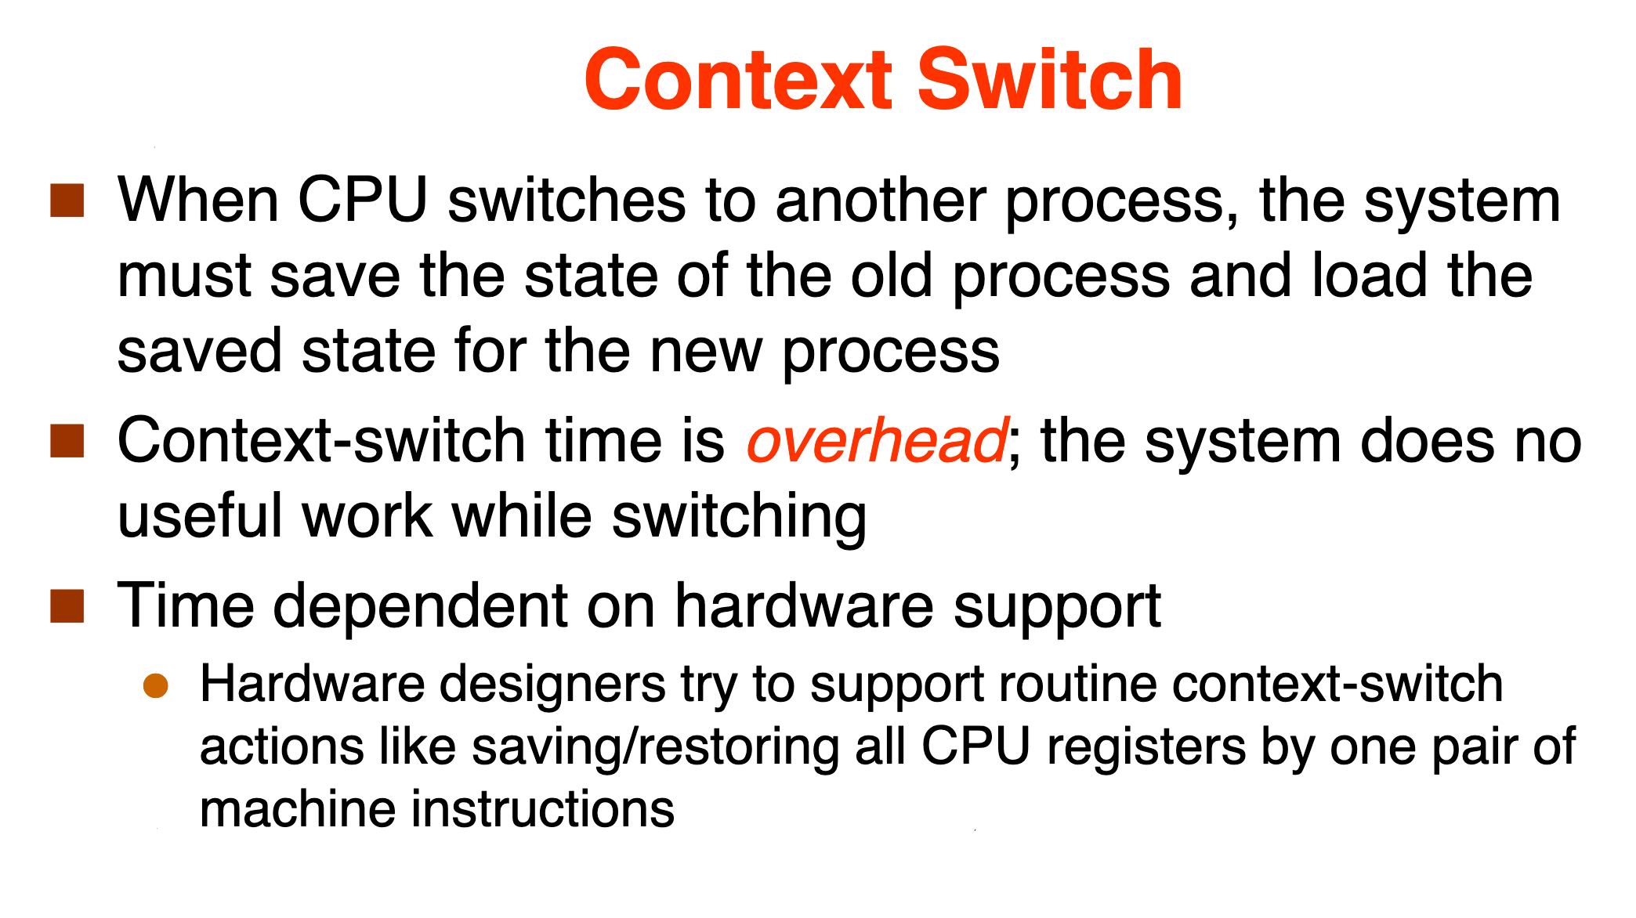
How processors work?

Slide 21
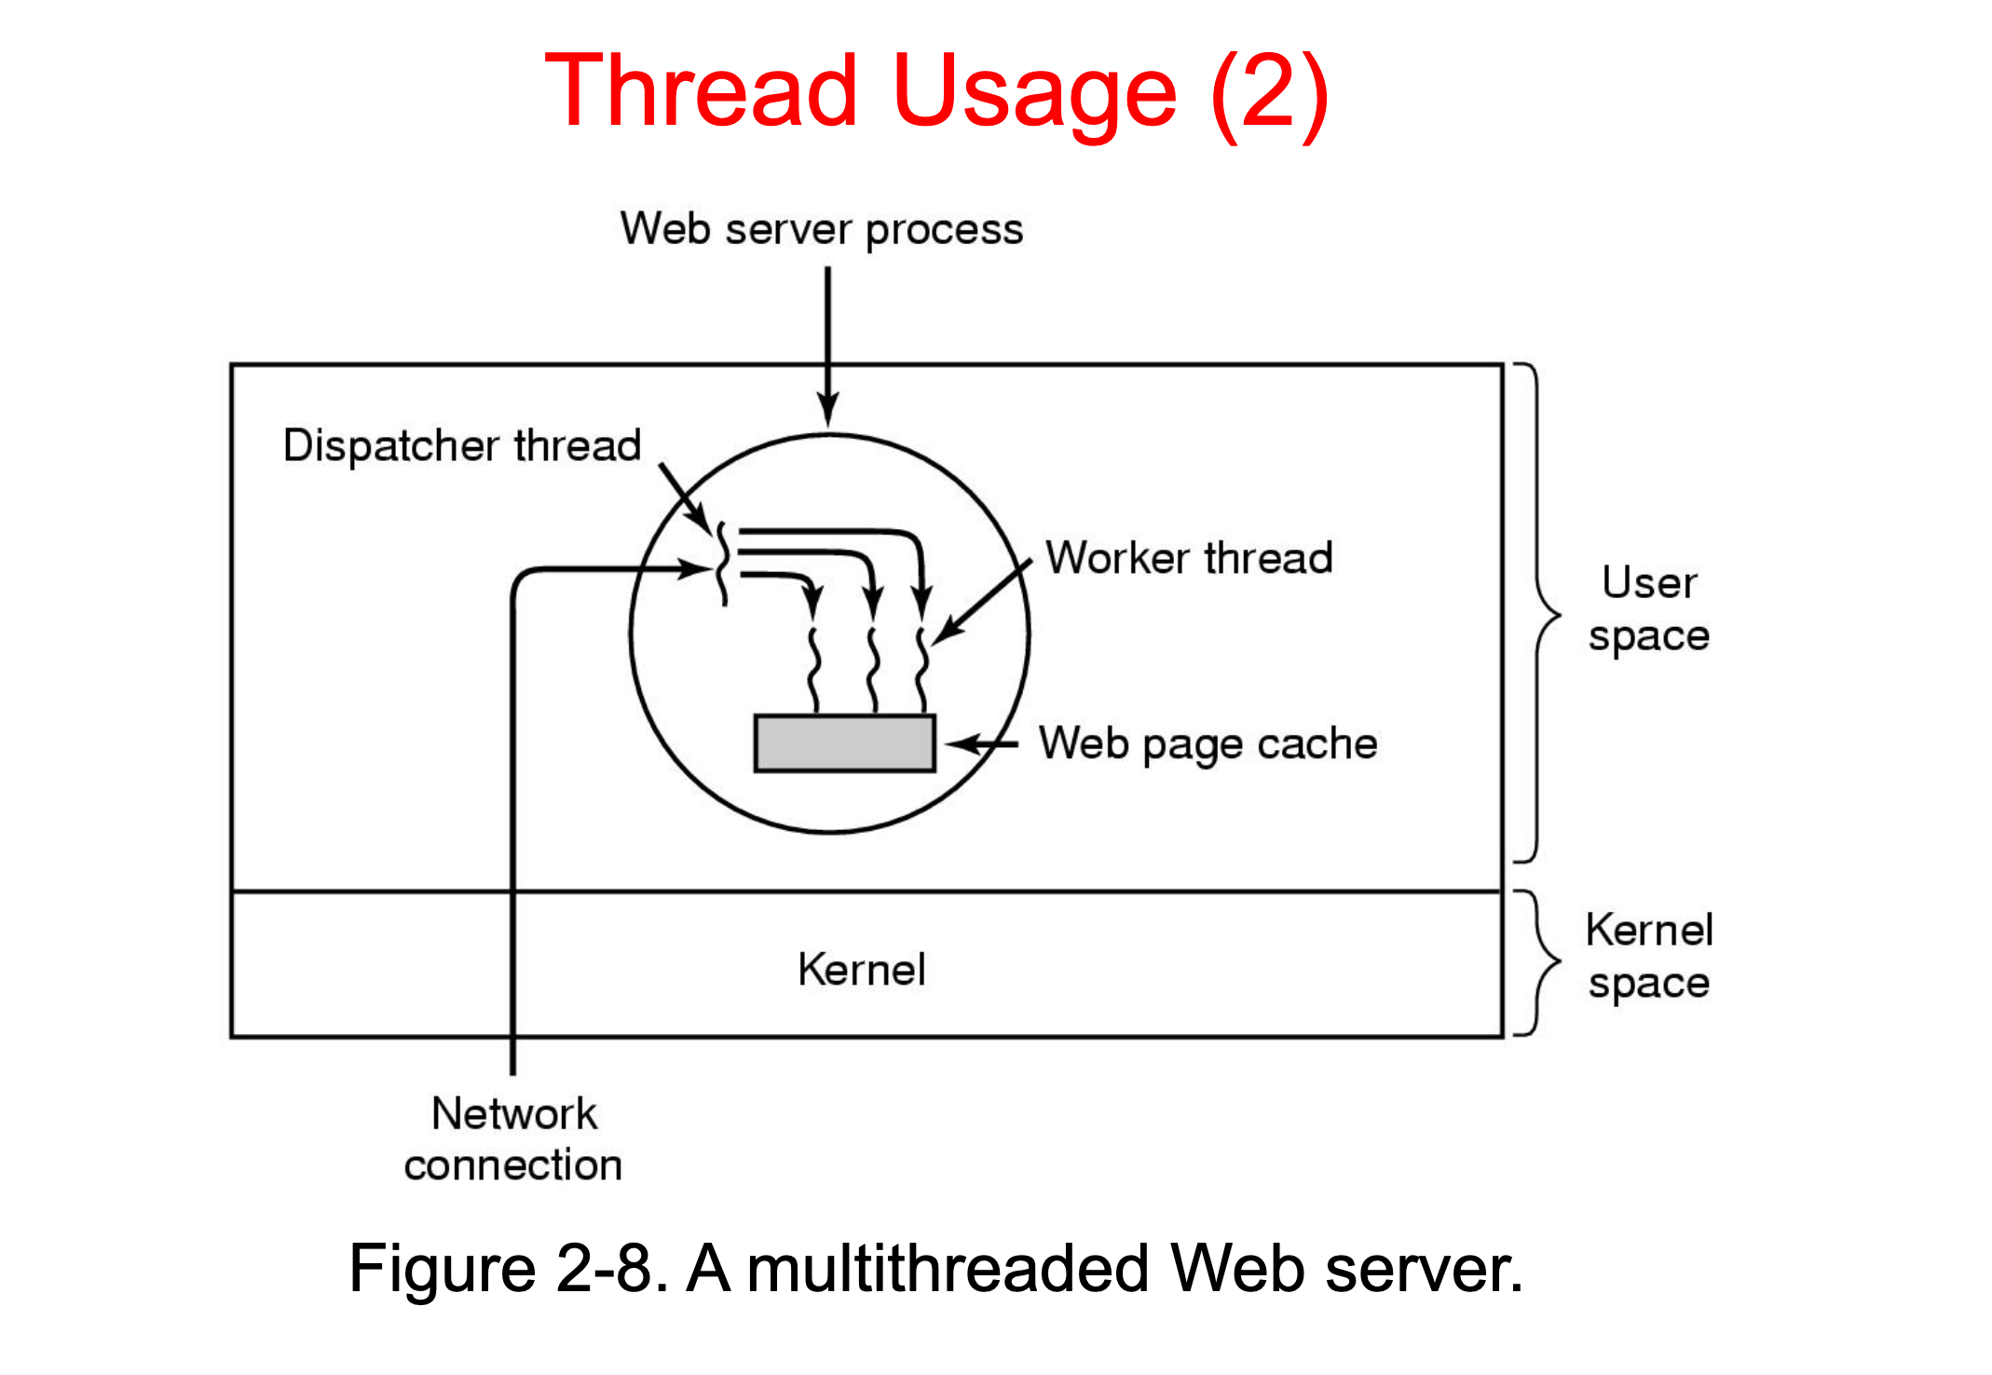
How processors work?

Slide 22
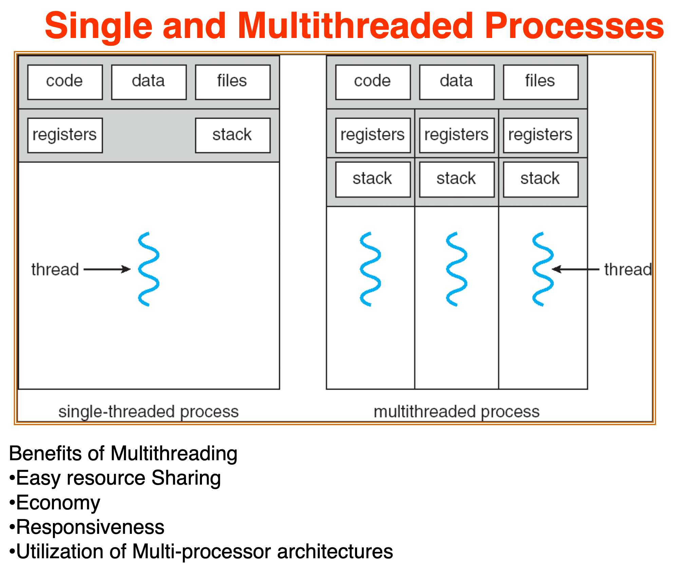
How processors work?

Slide 23
Java basics

Slide 24
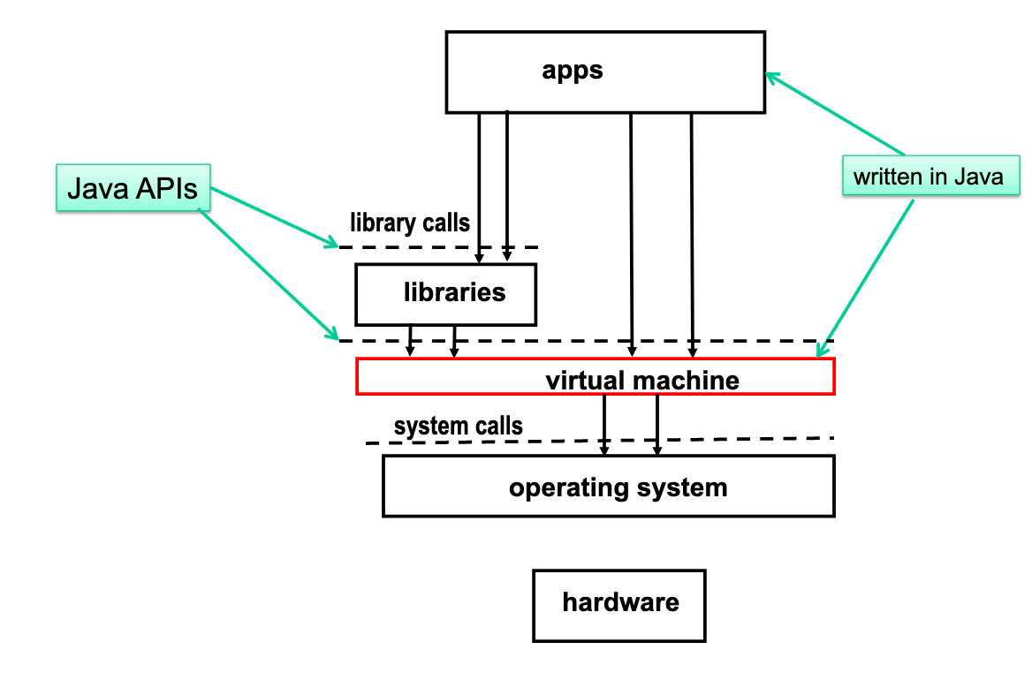
JVM execution architecture

Slide 25
How processors work?

Slide 26
Concurrent computing is a form of computing in which several computations are executed during overlapping time periods—concurrently—instead of sequentially (one completing before the next starts)
Definition

Slide 27
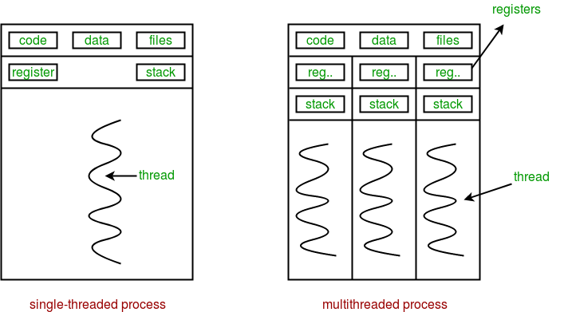
Sequential vs concurrent

Slide 28
Performance

Slide 29
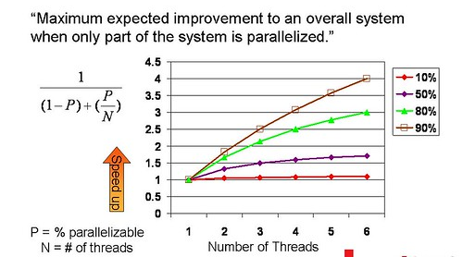
Amdahl's law

Slide 30
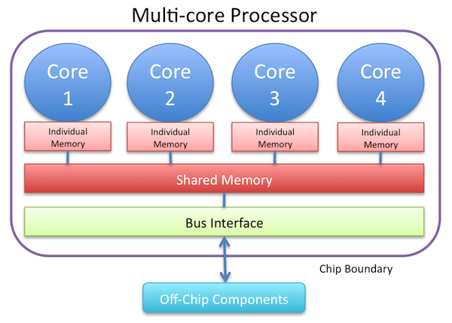
Resource utilization

Slide 31
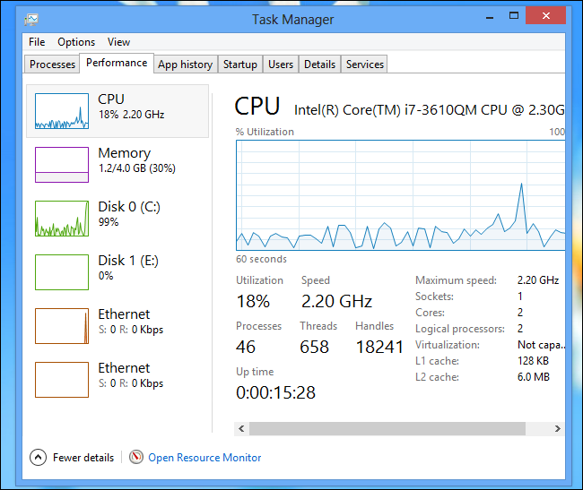
Resource utilization

Slide 32
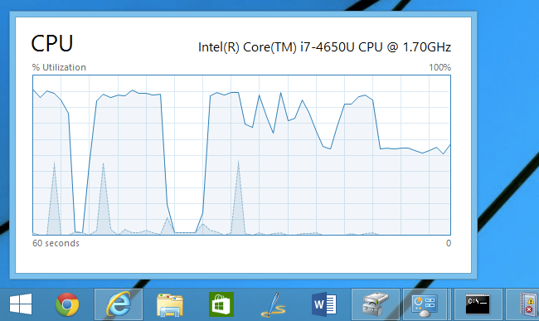
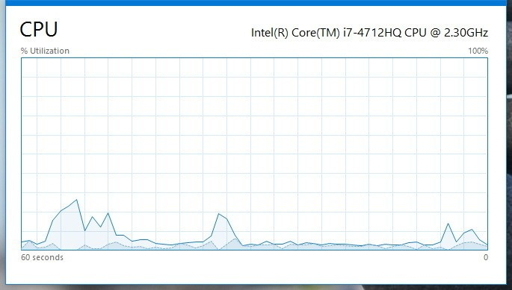
Resource utilization

Slide 33
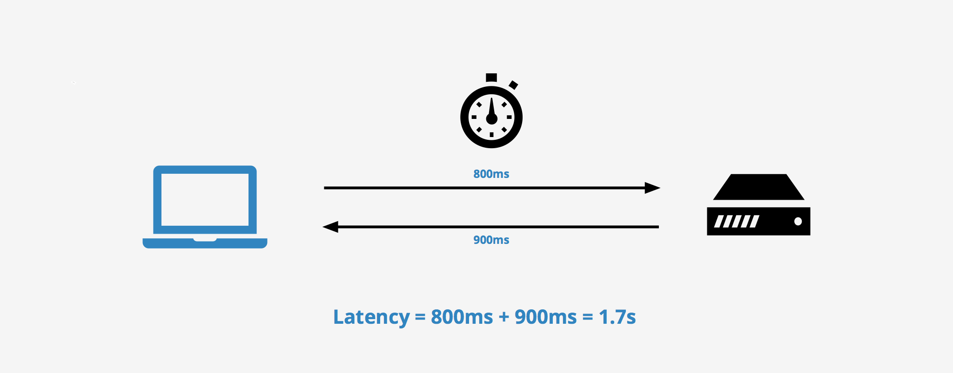
Latency

Slide 34

Modern way

Slide 35
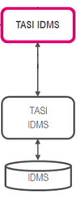
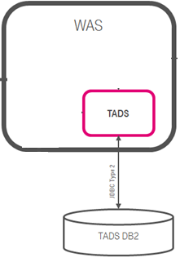
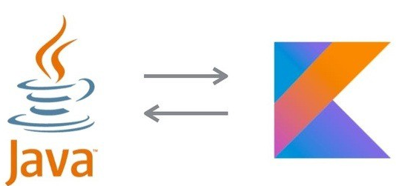
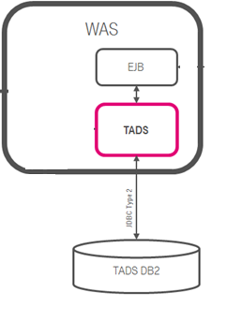
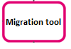

Concurrent Dijkstra algorithm

Slide 36
Multi thread migration

Slide 37
Single thread migration
7h21 min 1.7 r/s

Slide 38
Multi thread migration

Slide 39
Multi thread migration
7h21 min 1.7 r/s
28 min 23 r/s

Slide 40

The show begins

Slide 41
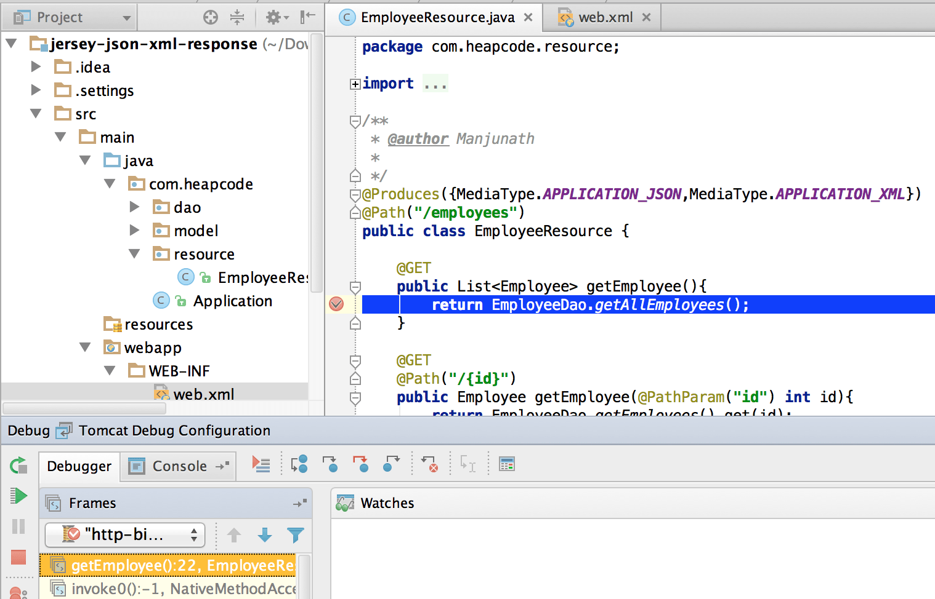
#1 Difficult to debug

Slide 42
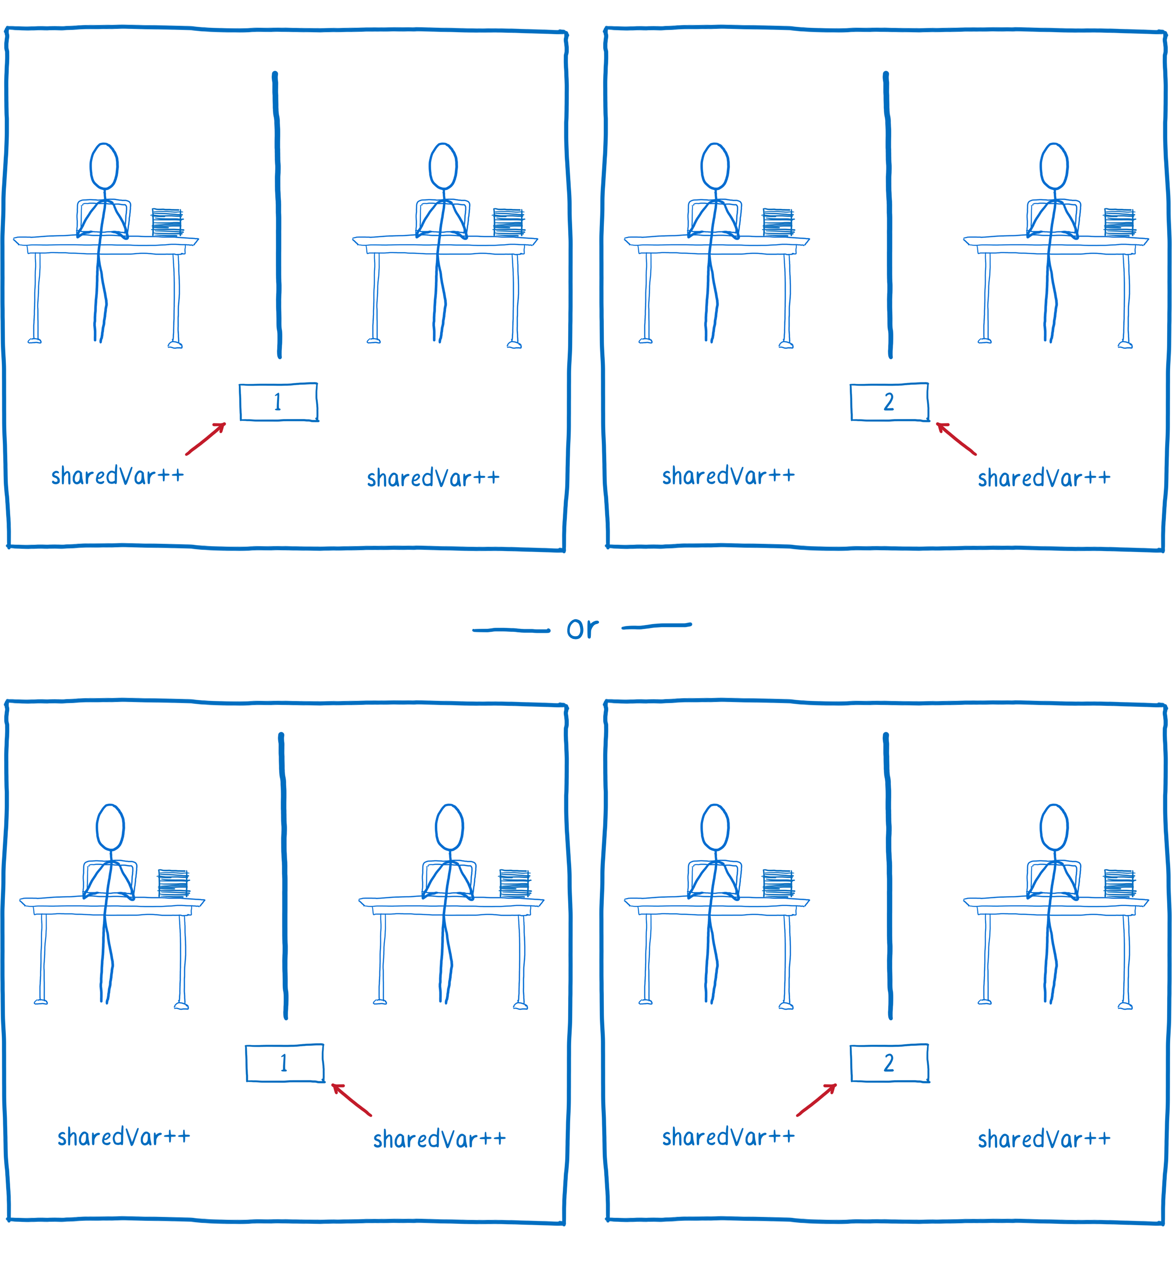
#2 Race condition

Slide 43
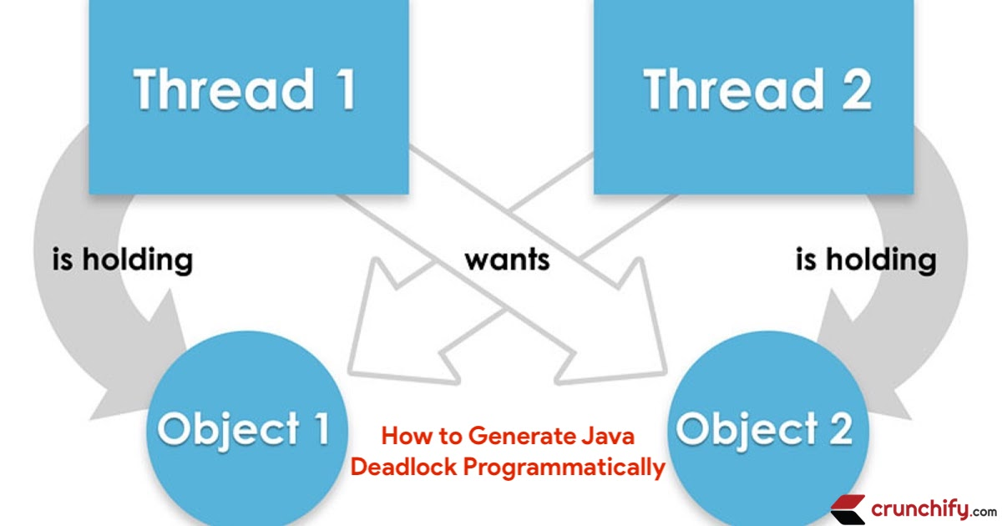
#3 Dead locks

Slide 44
Concurrency mad stuff
“But I don’t want to go among mad people," Alice remarked. - "Oh, you can’t help that," said the Cat: "we’re all mad here. I’m mad. You’re mad." - "How do you know I’m mad?" said Alice. - "You must be," said the Cat, "or you wouldn’t have come here.”
Alice's Adventures in
Wonderland by Lewis Carroll

Slide 45
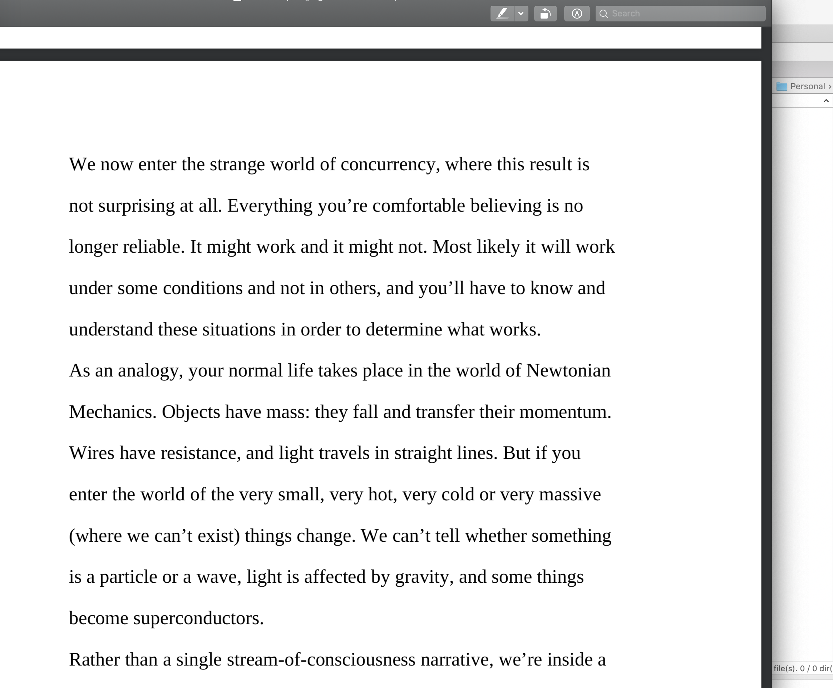

Dev practices
On Java 8 by Bruce Eckel

Slide 46
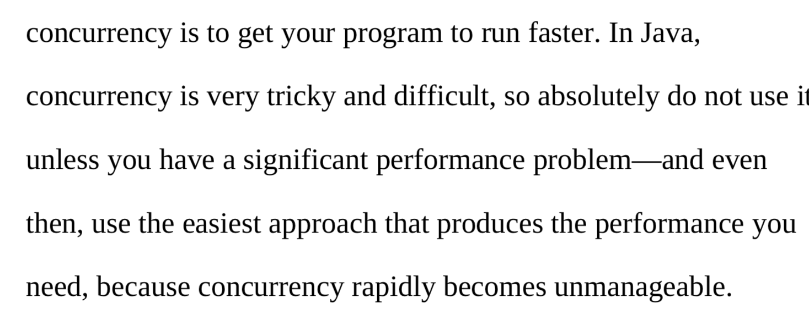

Dev practices
On Java 8 by Bruce Eckel

Slide 47
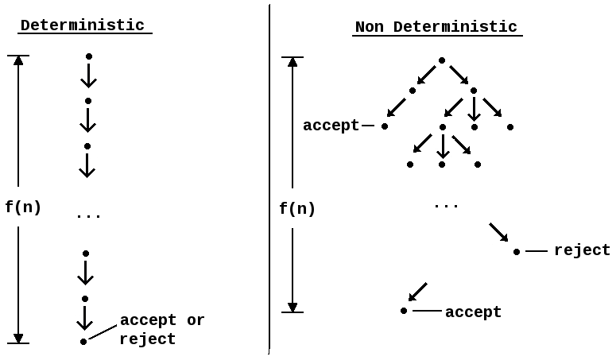
#4 Non deterministic behavior

Slide 48
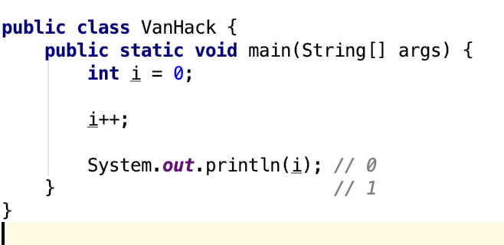
#4 Non deterministic behavior

Slide 49
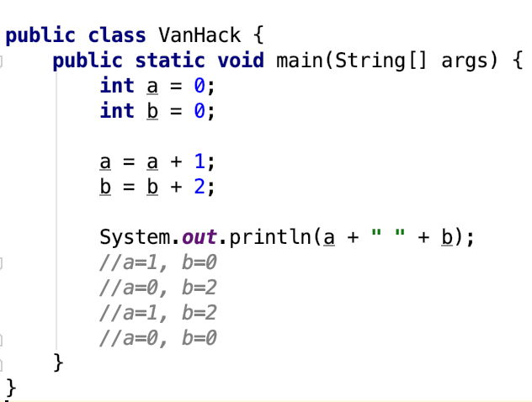
#4 Non deterministic behavior

Slide 50
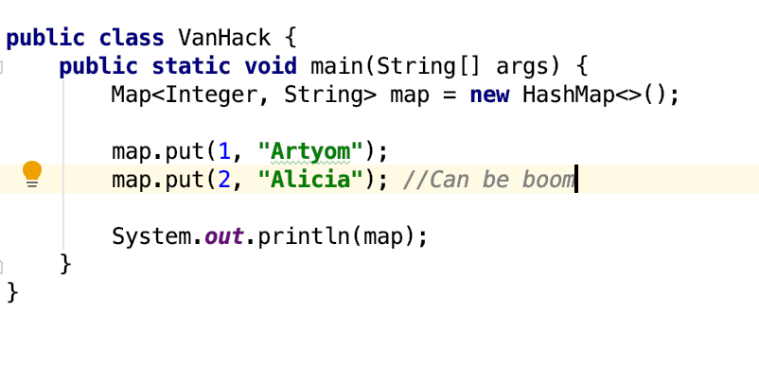
#4 Non deterministic behavior

Slide 51
Are you still here?
Twas brillig, and the slithy toves Did gyre and gimble in the wabe: All mimsy were the borogoves, And the mome raths outgrabe
Jabberwocky by Lewis Carroll

Slide 52

Let’s continue?

Slide 53
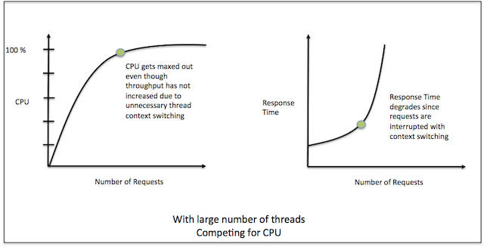
#5 Performance degradation

Slide 54
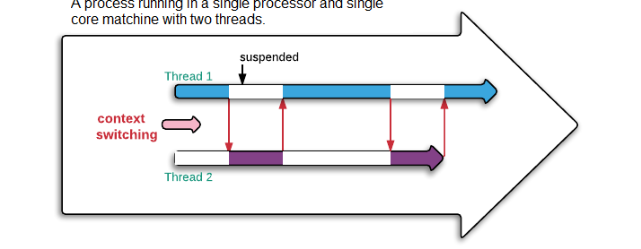
#5 Performance degradation

Slide 55
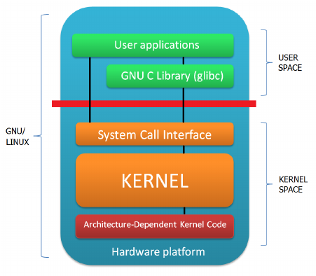
#6 OS limitation

Slide 56

Stop it? Hell no…

Slide 57

#7 Hardware unpredictable optimizations

Slide 58
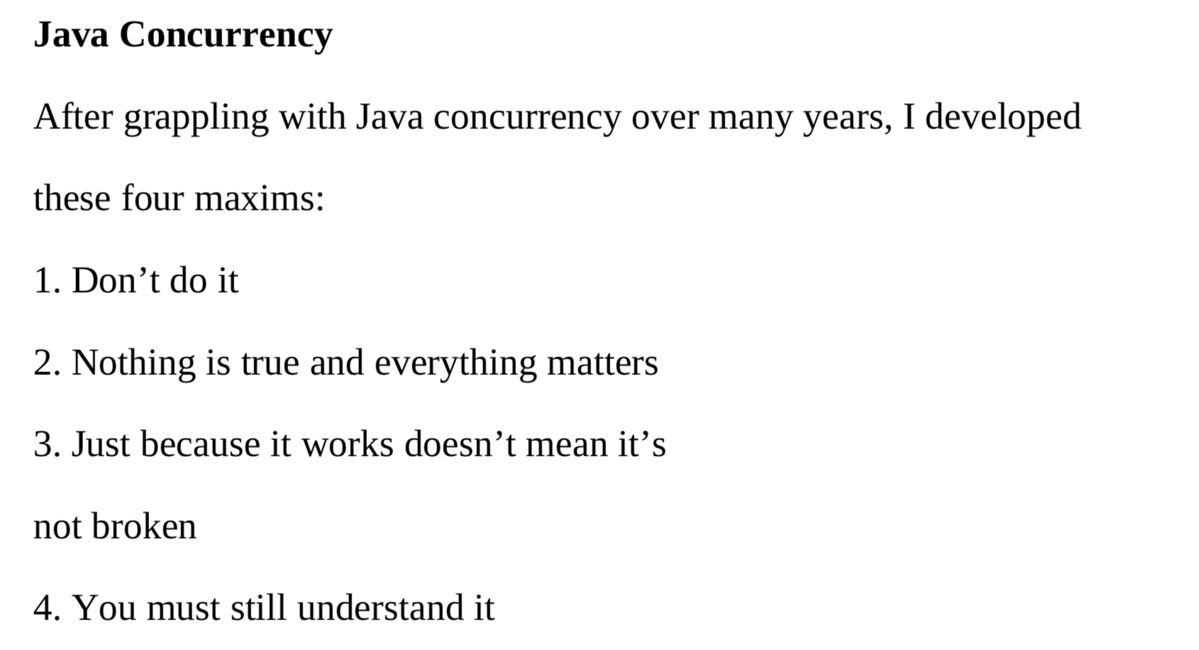
Concurrency in real world
On Java 8 by Bruce Eckel

Slide 59
Conclusion
Concurrency is powerful practice, you can achieve a lot using it
Don’t use concurrency if you can avoid it
Use best practices by experts
Use frameworks with big professional community
Minimize synchronization and data sharing
Perform load and stress testing
Use as much as possible existed solutions
Don’t forget about mad world and wonders

Slide 60
Resources
Java concurrency in practice (Brian Goetz )
On Java 8 (Bruce Eckel)
The Art of Multiprocessor Programming (Maurice Herlihy , Nir Shavit )

Slide 61
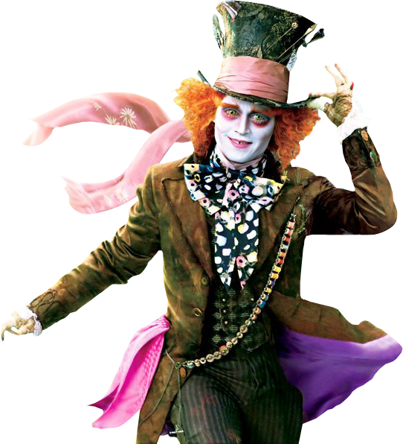
THANK YOU!
artyom-karnov@yandex.ru, Saint-Petersburg, 2019

